Slide 1


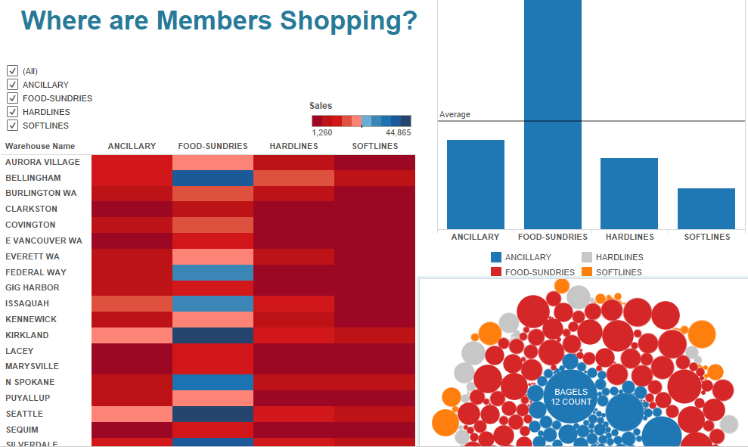
Sketch and Wireframing
Notes:
Explain data types:
● Categorical (also Qualitative)
○ Categorical variables represent types of data which may be divided into groups
○ Examples of categorical variables are race, sex, age group, and educational level
● Numerical (also Quantitative)
○ Values of a quantitative variable can be ordered and measured
○ Examples include age, height, sales, volume
○ Numbers are not always numerical data. Example: Gender (0=Male, 1=Female)
Instructor: Ask the class to identify the data types present in the dataset:
● States
● Funds raised
● Date/time (can be both)
○ Months of the year - categorical
○ Date and time of project creation - numerical
Numerical data can be evaluated using a few summary metrics. Here are four very useful ones with which to start:
● Count( )
● Min( )
● Max( )
● Average( )
● Demonstrate calculating each measure on a single sample set of numbers.
● Explain why it’s important to always use these summary metrics when doing exploratory analysis.

Slide 2

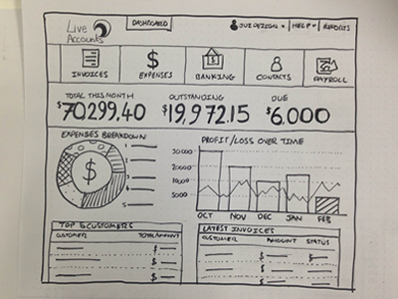
Sketch and Wireframing
Notes:
Explain data types:
● Categorical (also Qualitative)
○ Categorical variables represent types of data which may be divided into groups
○ Examples of categorical variables are race, sex, age group, and educational level
● Numerical (also Quantitative)
○ Values of a quantitative variable can be ordered and measured
○ Examples include age, height, sales, volume
○ Numbers are not always numerical data. Example: Gender (0=Male, 1=Female)
Instructor: Ask the class to identify the data types present in the dataset:
● States
● Funds raised
● Date/time (can be both)
○ Months of the year - categorical
○ Date and time of project creation - numerical
Numerical data can be evaluated using a few summary metrics. Here are four very useful ones with which to start:
● Count( )
● Min( )
● Max( )
● Average( )
● Demonstrate calculating each measure on a single sample set of numbers.
● Explain why it’s important to always use these summary metrics when doing exploratory analysis.

Slide 3
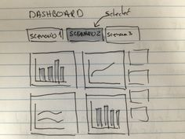
Sketch and Wireframing
Notes:
Explain data types:
● Categorical (also Qualitative)
○ Categorical variables represent types of data which may be divided into groups
○ Examples of categorical variables are race, sex, age group, and educational level
● Numerical (also Quantitative)
○ Values of a quantitative variable can be ordered and measured
○ Examples include age, height, sales, volume
○ Numbers are not always numerical data. Example: Gender (0=Male, 1=Female)
Instructor: Ask the class to identify the data types present in the dataset:
● States
● Funds raised
● Date/time (can be both)
○ Months of the year - categorical
○ Date and time of project creation - numerical
Numerical data can be evaluated using a few summary metrics. Here are four very useful ones with which to start:
● Count( )
● Min( )
● Max( )
● Average( )
● Demonstrate calculating each measure on a single sample set of numbers.
● Explain why it’s important to always use these summary metrics when doing exploratory analysis.

Slide 4

Lesson Material
Projects
Notes:
Explain data types:
● Categorical (also Qualitative)
○ Categorical variables represent types of data which may be divided into groups
○ Examples of categorical variables are race, sex, age group, and educational level
● Numerical (also Quantitative)
○ Values of a quantitative variable can be ordered and measured
○ Examples include age, height, sales, volume
○ Numbers are not always numerical data. Example: Gender (0=Male, 1=Female)
Instructor: Ask the class to identify the data types present in the dataset:
● States
● Funds raised
● Date/time (can be both)
○ Months of the year - categorical
○ Date and time of project creation - numerical
Numerical data can be evaluated using a few summary metrics. Here are four very useful ones with which to start:
● Count( )
● Min( )
● Max( )
● Average( )
● Demonstrate calculating each measure on a single sample set of numbers.
● Explain why it’s important to always use these summary metrics when doing exploratory analysis.

Slide 5
Lesson Material
TWB & TWBX
Projects
Notes:
Explain data types:
● Categorical (also Qualitative)
○ Categorical variables represent types of data which may be divided into groups
○ Examples of categorical variables are race, sex, age group, and educational level
● Numerical (also Quantitative)
○ Values of a quantitative variable can be ordered and measured
○ Examples include age, height, sales, volume
○ Numbers are not always numerical data. Example: Gender (0=Male, 1=Female)
Instructor: Ask the class to identify the data types present in the dataset:
● States
● Funds raised
● Date/time (can be both)
○ Months of the year - categorical
○ Date and time of project creation - numerical
Numerical data can be evaluated using a few summary metrics. Here are four very useful ones with which to start:
● Count( )
● Min( )
● Max( )
● Average( )
● Demonstrate calculating each measure on a single sample set of numbers.
● Explain why it’s important to always use these summary metrics when doing exploratory analysis.

Slide 6
Flower and Wine Challenge
We must have perseverance and above all confidence in ourselves. We must believe that we are gifted for something and that this thing must be attained.
— Marie Curie, Physicist and Chemist
Value of Data

Slide 7


Flowers & Wine Challenge
Notes:
Explain data types:
● Categorical (also Qualitative)
○ Categorical variables represent types of data which may be divided into groups
○ Examples of categorical variables are race, sex, age group, and educational level
● Numerical (also Quantitative)
○ Values of a quantitative variable can be ordered and measured
○ Examples include age, height, sales, volume
○ Numbers are not always numerical data. Example: Gender (0=Male, 1=Female)
Instructor: Ask the class to identify the data types present in the dataset:
● States
● Funds raised
● Date/time (can be both)
○ Months of the year - categorical
○ Date and time of project creation - numerical
Numerical data can be evaluated using a few summary metrics. Here are four very useful ones with which to start:
● Count( )
● Min( )
● Max( )
● Average( )
● Demonstrate calculating each measure on a single sample set of numbers.
● Explain why it’s important to always use these summary metrics when doing exploratory analysis.

Slide 8
Flowers & Wine Challenge
Notes:
Explain data types:
● Categorical (also Qualitative)
○ Categorical variables represent types of data which may be divided into groups
○ Examples of categorical variables are race, sex, age group, and educational level
● Numerical (also Quantitative)
○ Values of a quantitative variable can be ordered and measured
○ Examples include age, height, sales, volume
○ Numbers are not always numerical data. Example: Gender (0=Male, 1=Female)
Instructor: Ask the class to identify the data types present in the dataset:
● States
● Funds raised
● Date/time (can be both)
○ Months of the year - categorical
○ Date and time of project creation - numerical
Numerical data can be evaluated using a few summary metrics. Here are four very useful ones with which to start:
● Count( )
● Min( )
● Max( )
● Average( )
● Demonstrate calculating each measure on a single sample set of numbers.
● Explain why it’s important to always use these summary metrics when doing exploratory analysis.

Slide 9
Tableau
EXIT TICKETS
Name of class : Flower and Wine Challenge
Question : What is most important to you? What is most important to your Audience?
Contact: MatthewMorris.DA@gmail.com

Slide 10
18

Slide 11
Course Outline
Value of Data and Business
Prepare Data in Excel
Clean Data in Excel
Dynamic Data Referencing
Dynamic Data Aggregation
Conditional Formatting\Aggregation
Value of Databases
Data Aggregation in SQL
More Data Aggregation in SQL
Efficient and Dynamic Queries
Present Analysis Results
Statistics to Validate Analysis
Predictive Analysis
Tableau Project Flow
Dashboard Design
Track Metrics with Dashboards
Effective Presentations with Data
Flexible Session
Final Project Presentation

Slide 12
Review Course
Fall seven times and stand up eight.
– Japanese Proverb

Slide 13
Flex Day
Review/Workshop
Projects
Notes:
Explain data types:
● Categorical (also Qualitative)
○ Categorical variables represent types of data which may be divided into groups
○ Examples of categorical variables are race, sex, age group, and educational level
● Numerical (also Quantitative)
○ Values of a quantitative variable can be ordered and measured
○ Examples include age, height, sales, volume
○ Numbers are not always numerical data. Example: Gender (0=Male, 1=Female)
Instructor: Ask the class to identify the data types present in the dataset:
● States
● Funds raised
● Date/time (can be both)
○ Months of the year - categorical
○ Date and time of project creation - numerical
Numerical data can be evaluated using a few summary metrics. Here are four very useful ones with which to start:
● Count( )
● Min( )
● Max( )
● Average( )
● Demonstrate calculating each measure on a single sample set of numbers.
● Explain why it’s important to always use these summary metrics when doing exploratory analysis.

Slide 14
19

Slide 15
Course Outline
Value of Data and Business
Prepare Data in Excel
Clean Data in Excel
Dynamic Data Referencing
Dynamic Data Aggregation
Conditional Formatting\Aggregation
Value of Databases
Data Aggregation in SQL
More Data Aggregation in SQL
Efficient and Dynamic Queries
Present Analysis Results
Statistics to Validate Analysis
Predictive Analysis
Tableau Project Flow
Dashboard Design
Track Metrics with Dashboards
Effective Presentations with Data
Flexible Session
Final Project Presentation

Slide 16
Final project Presentation
A ship in port is safe, but that’s not what ships are built for.
— Grace Hopper, Computer Scientist
Value of Data

Slide 17



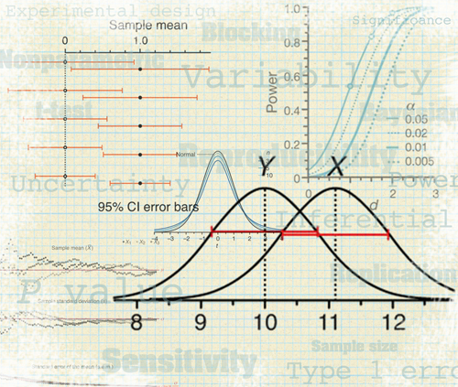
Overview of Course
Course Objectives

Slide 19


Slide 20


